Slide 1
AI NATIVE PLATFORM ENGINEERING
AGENTS AS THE PRIMARY CONSUMERS
Presenter: Jeffrey Aven
STACKQL>>

Slide 2
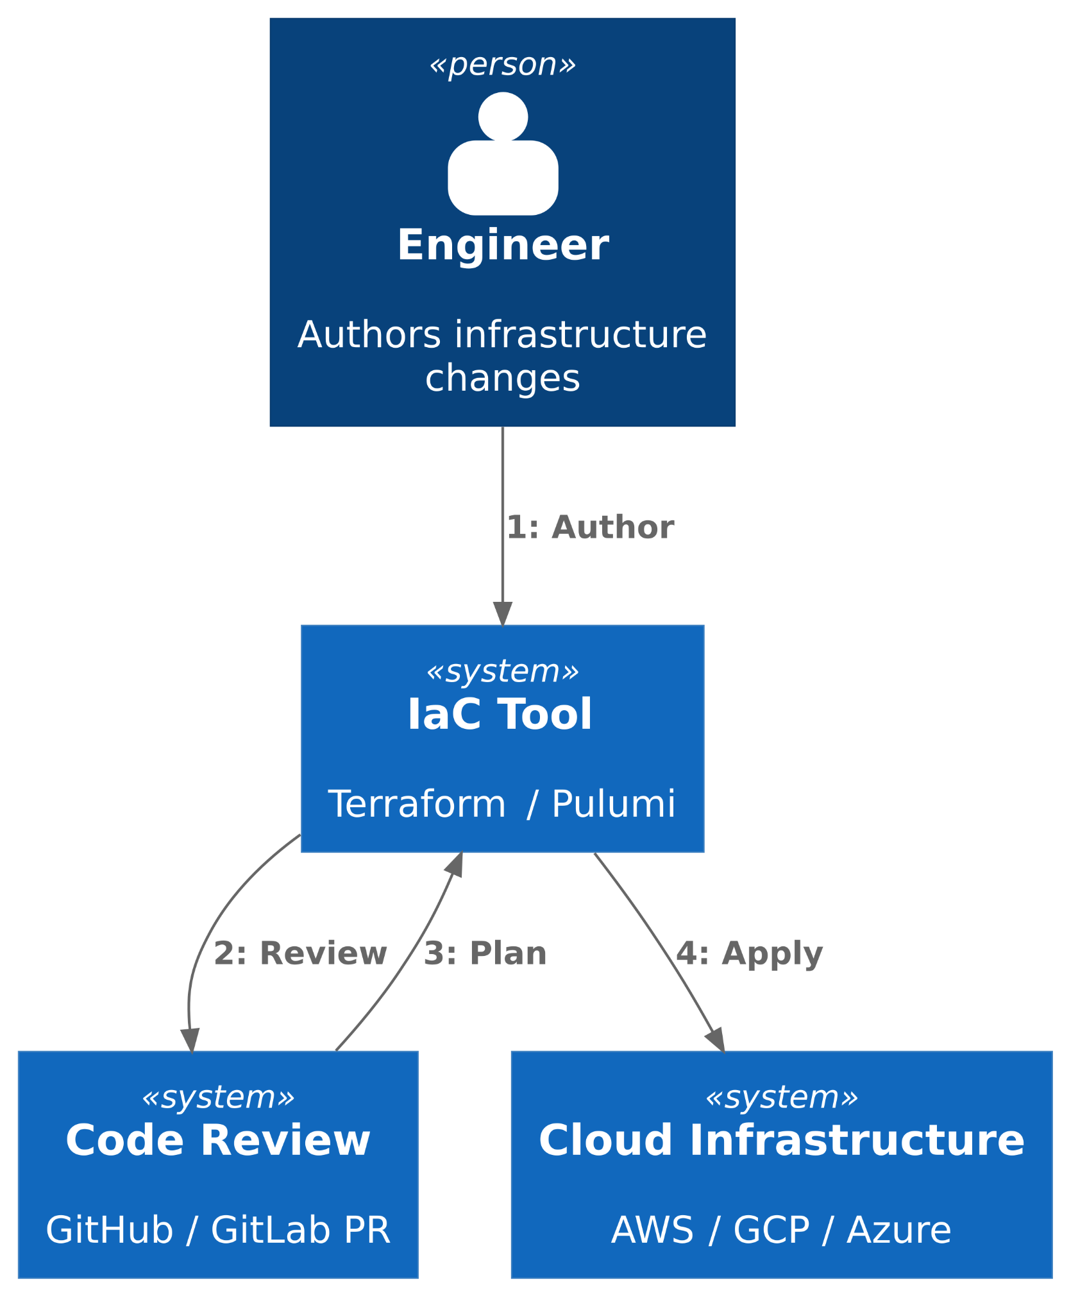

WHAT IaC WAS BUILT FOR
Humans author the changes.
Changes at human timescales.
One writer per environment.
Drift is an exception.
STACKQL>>
Notes:
Four assumptions, all reasonable in 2015.
Humans authored the changes.
Changes happened at human timescales, which is to say minutes to days.
One writer per environment, enforced by review and state locking.
And drift was an exception, something you fixed and then went back to the steady state.
These assumptions held for a decade.

Slide 3
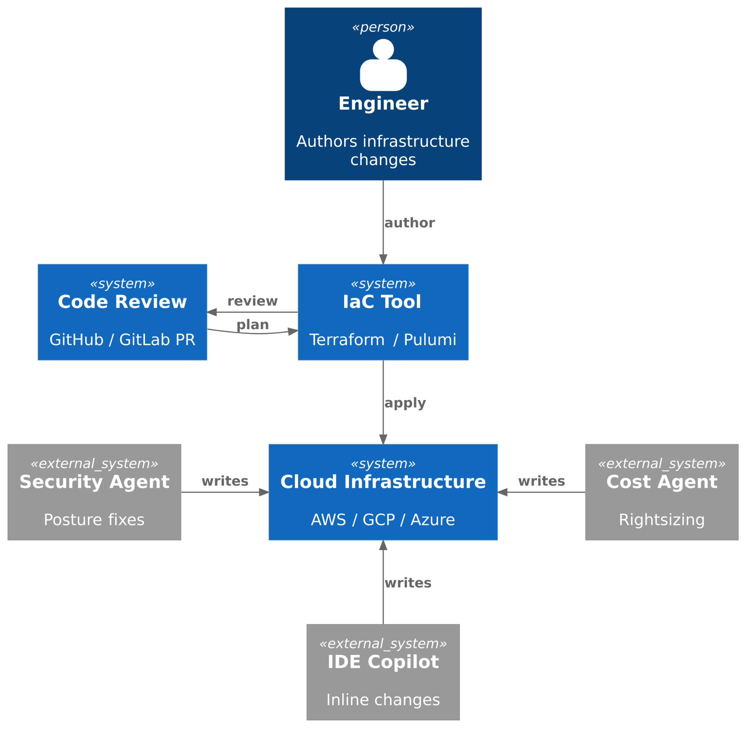

AI CHANGES EVERYTHING
Agents AND humans can author changes.
Changes at machine speed.
Multiple writers, at the same time.
Drift is the default state.
STACKQL>>
Notes:
Every one of those assumptions inverts under agents.
Agents and humans both author changes.
Changes happen at machine speed, dozens per minute.
Multiple writers operate at the same time without coordinating.
And drift is no longer the exception; it is the default state of the system.
The model we had is now broken.

Slide 4
DRIFT ISN’T AN ERROR
IT’S A SIGNAL
2015
2026
log it, page someone
let the agent decide
STACKQL>>
Notes:
Drift was a binary alarm.
It went off occasionally, someone reconciled it, and you went back to flat.
In 2026, drift is a continuous waveform.
It is the signal of what your system is actually doing.
Treating it as an error to suppress means missing the only telemetry you have.
decide, don't just detect
2015 drift -> log it, page someone
2026 drift -> it's the default state, so the agent must decide:
auto-remediate / escalate / accept

Slide 5
WHERE THE MODEL STRAINS
WHERE THE MODEL SHOWS IT’S AGE
01 - SINGLE WRITERS
02 - HUMAN CENTRIC
03 - OPINIONATED
04 - BOUNDED
STACKQL>>
Notes:
Four specific places the model breaks.
Single-writer state.
Plan and apply expecting a human.
Opinionated abstractions.
And the control plane / data plane split.
Let me take each one briefly.

Slide 6
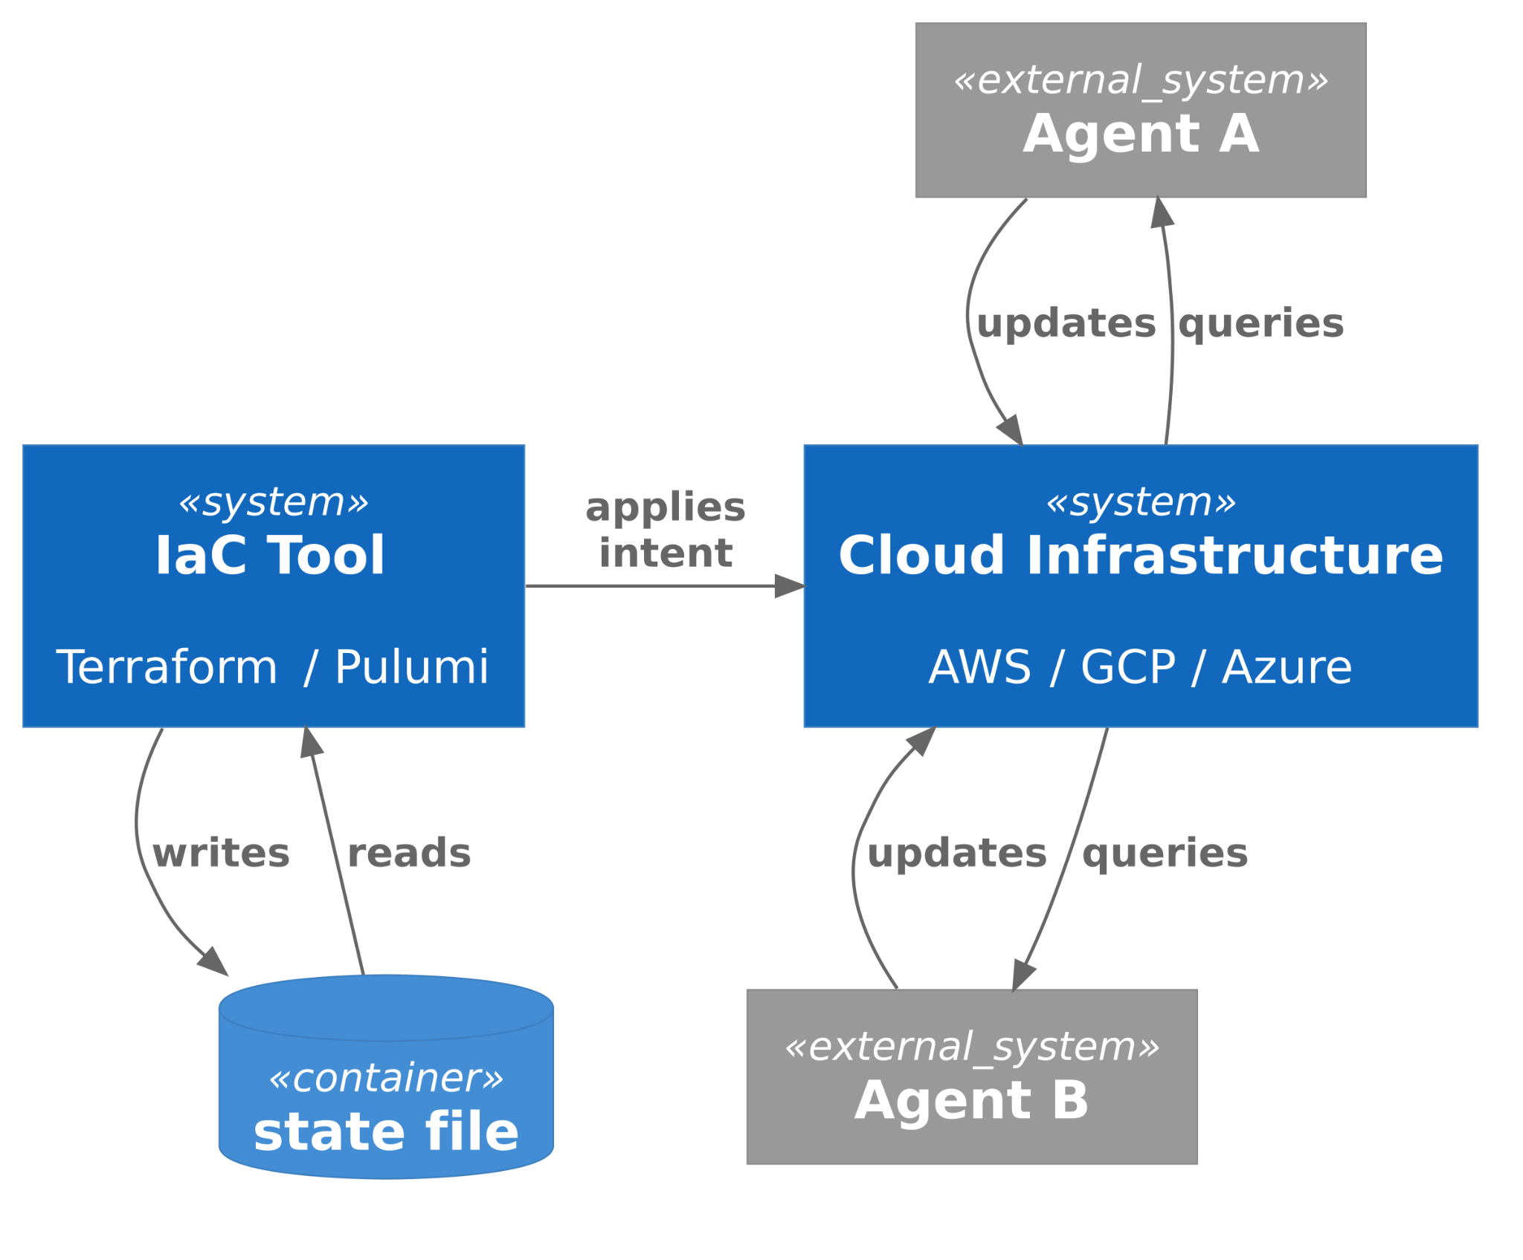
01
SINGLE-WRITER STATE
State files cache what one tool did.
They represent intent, not reality.
Multiple actors, no shared truth.
STACKQL>>
Notes:
The state file is a cache of what one tool did.
It is intent, not reality.
If a human, an agent, all touch the same resource, the state file is wrong within seconds.
The fix is not better locking.
The fix is recognising the state file is not the source of truth - the cloud is.

Slide 7
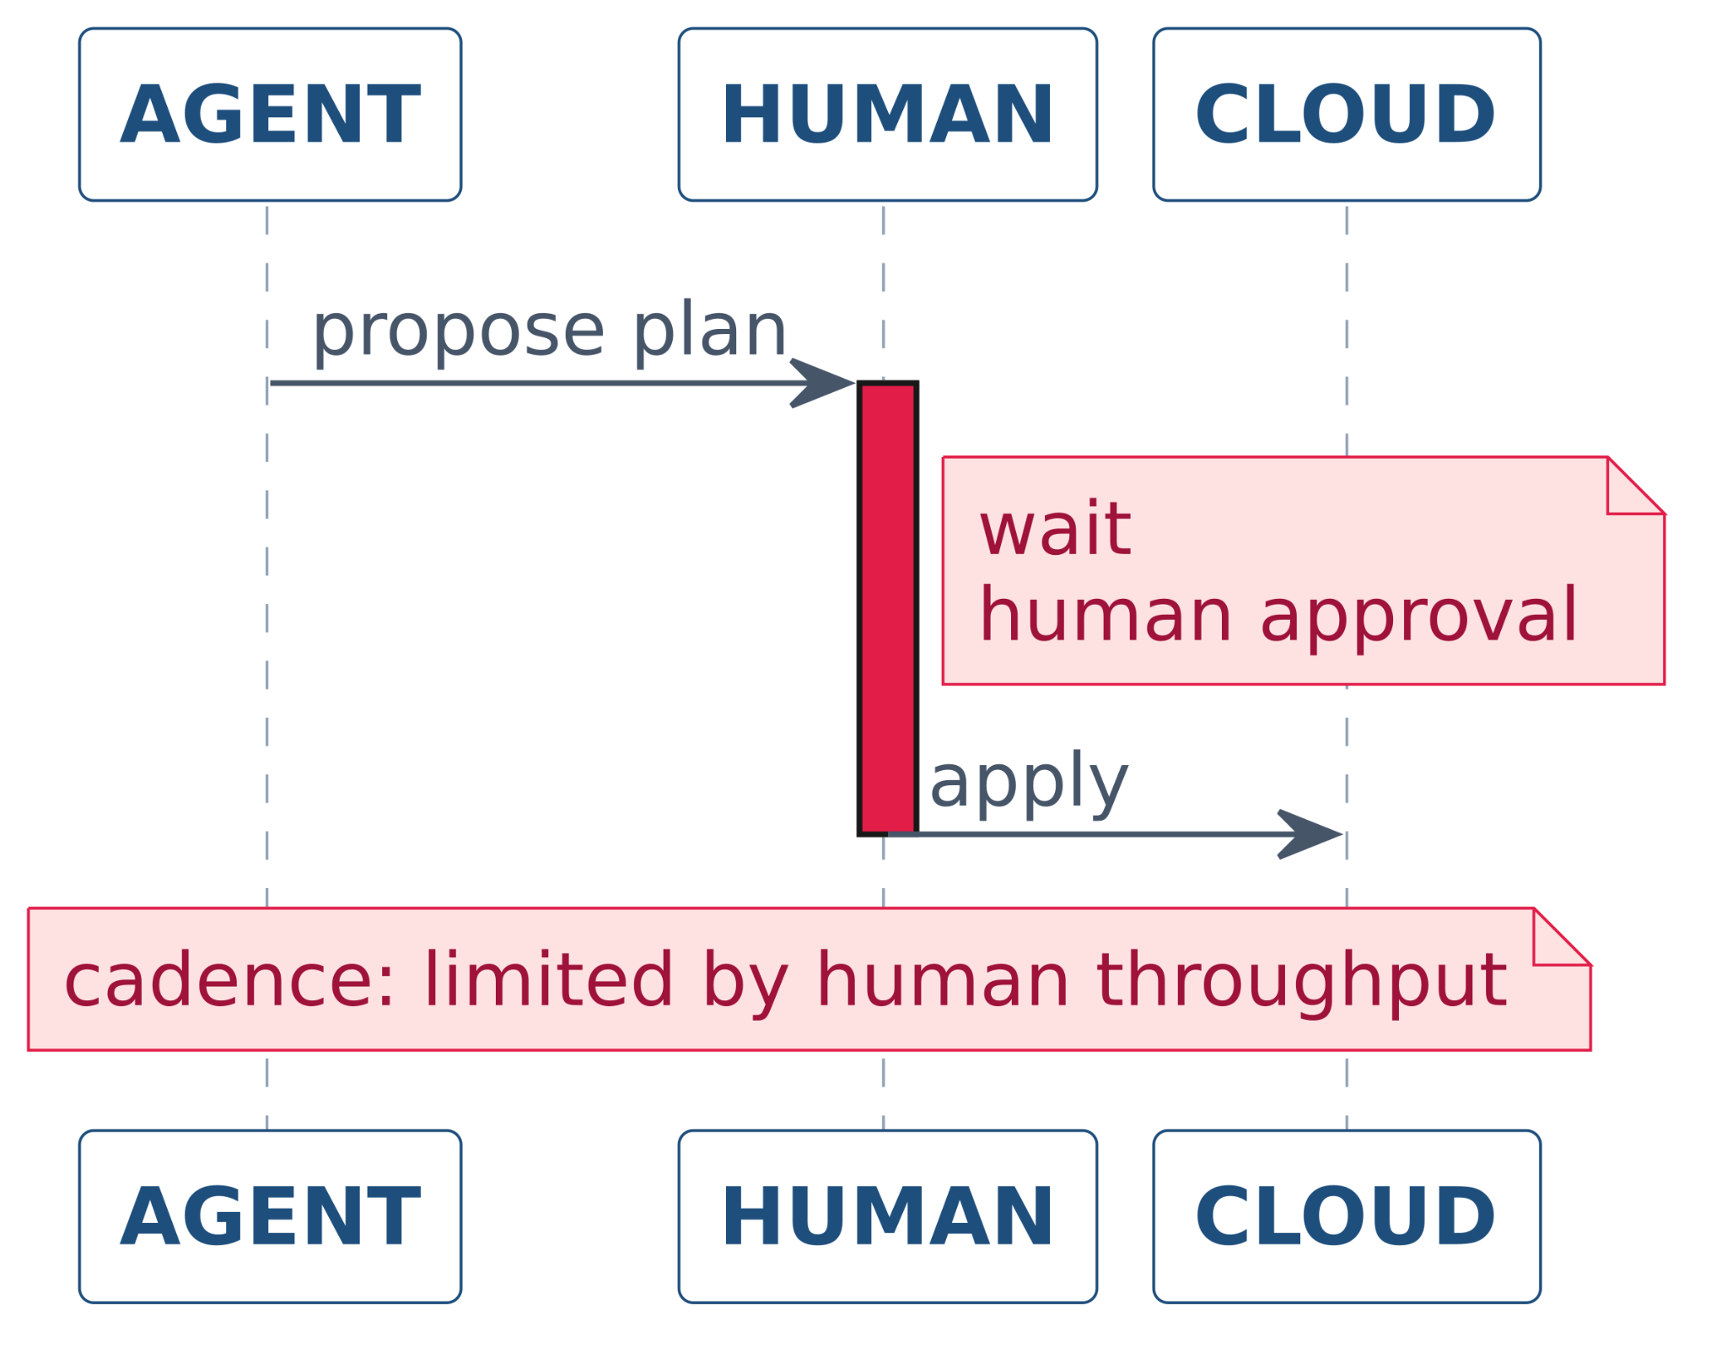
02
PLAN AND APPLY EXPECTS A HUMAN
The review cycle is the safety mechanism.
Agents operate outside the loop.
Safety can't depend on humans.
STACKQL>>
Notes:
The review cycle is doing the safety work.
A human looks at the plan, recognises something is off, and stops the apply.
Agents do not stop. They proceed.
So whatever safety we got from review has to move somewhere agents can use it, which means policy and assertion, not human inspection.

Slide 8
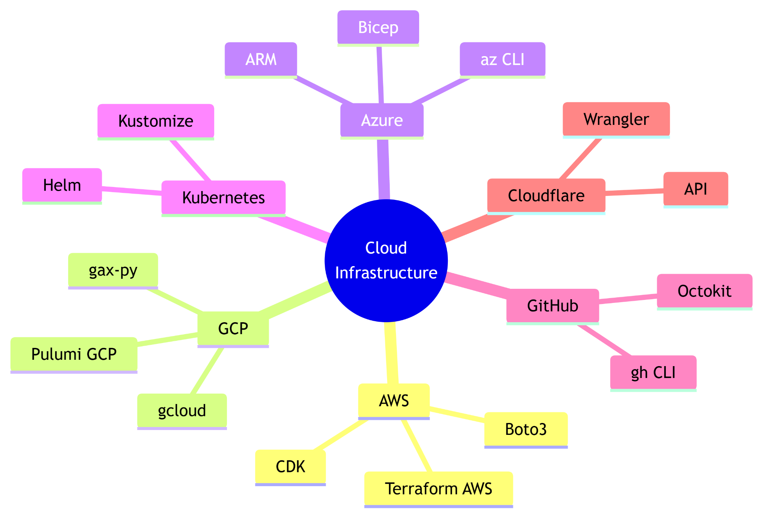
03
OPINIONATED ABSTRACTIONS
Multiple services, multiple ecosystems.
Each abstraction is a new surface.
What helps humans doesn’t always help agents.
STACKQL>>
Notes:
Each IaC tool implements its own DSL,
its own resource model,
its own ecosystem.
That is fine for humans, who learn one and stay there.
For an agent, every abstraction is a new surface to plan against and a new place to be wrong.
What helped humans does not always help agents.

Slide 9
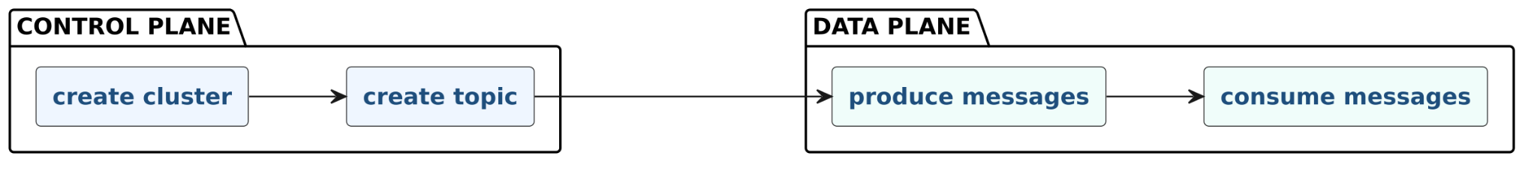

04
PLANE-BOUNDED
The control/data split becomes a constraint.
Agents need to traverse both.
The control plane and data plane are converging.
STACKQL>>
Notes:
IaC tools were built for the control plane.
Data plane operations - queries, grants, table-level access - lived in different tools.
Agents need to traverse both in a single decision.
The split is becoming a constraint, and the underlying APIs are already converging.

Slide 10
SO, WHERE TO FROM HERE?
THE MODEL FROM 2015, BREAKS IN 2026…
STACKQL>>
Notes:
So the 2015 model breaks in 2026. The question is what replaces it.

Slide 11
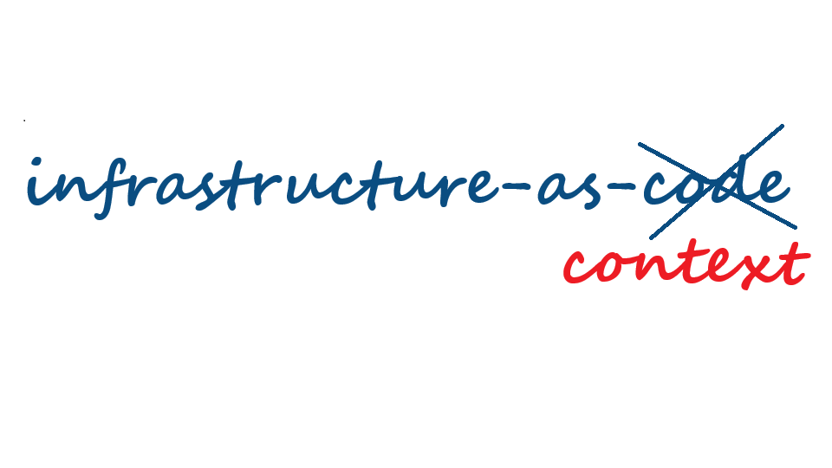
IaC IN THE AGENT ERA
STACKQL>>
Notes:
The reframe is small but consequential.

Slide 12

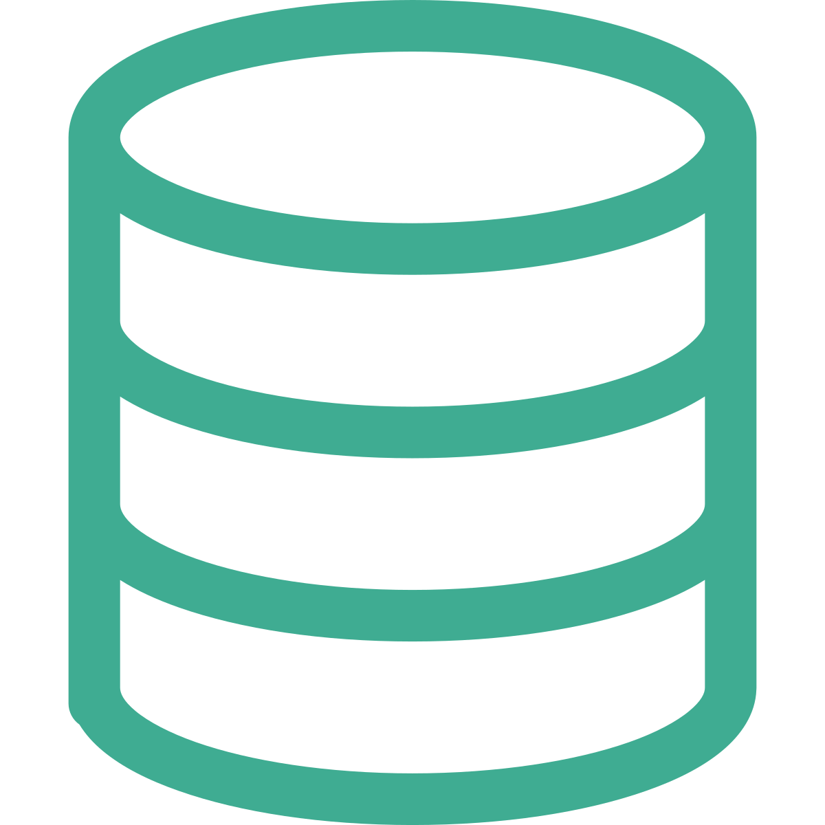
THE NEW CONTRACT
What agents need to query, reason about, and act on.
Infrastructure-as-Code
Infrastructure-as-Context
YOU WROTE IT
2015
AGENTS QUERY IT
2026
Code = Intent
Reality = Data
STACKQL>>
Notes:
Infrastructure-as-Code:intent lived in the code.
Infrastructure-as-Context: agents query it, the reality is data.
The deliverable changes from a file you wrote to a queryable view agents reason about. Code does not disappear. It just stops being the contract.

Slide 13
WHATS WORKING NOW
PATTERNS THAT HOLD UP IN THE AGENTIC ERA
01 - QUERY BEFORE MUTATION
02 - IDEMPOTENT ASSERTIONS
03 - BI-TEMPORAL VIEW
04 - AGENTS AS EVENT SOURCES
05 - UNIVERSAL INTERFACES
06 - POLICY GATES
STACKQL>>
Notes:
Several patterns are holding up in the agent era.
None of these are new ideas in isolation.
Applied together, they become the contract.

Slide 14
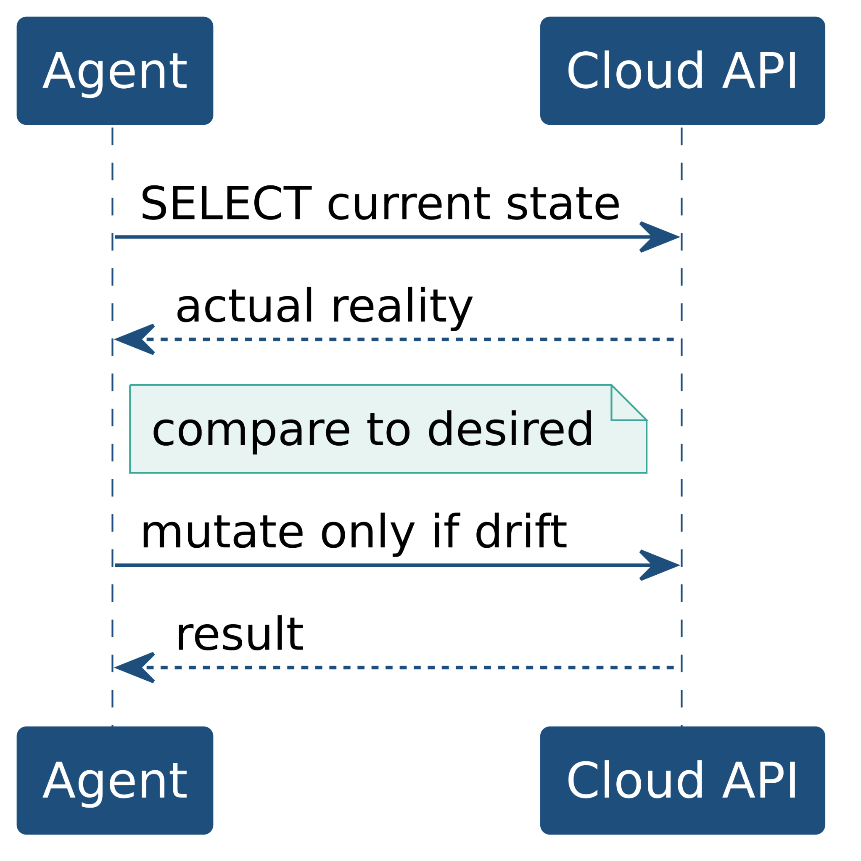
01
QUERY BEFORE MUTATION
Inspect reality, not the state file, before acting.
“A state file shows what a tool wrote last run. The cloud API shows what actually exists. Autonomous agents should read live state on every decision.”
STACKQL>>
Notes:
Inspect reality before acting. Not the state file.
The API. Every decision an agent makes should be grounded in what is actually there right now, not what some cache says was there ten minutes ago.
This is the cheapest pattern to adopt and the one that prevents the most damage.

Slide 15
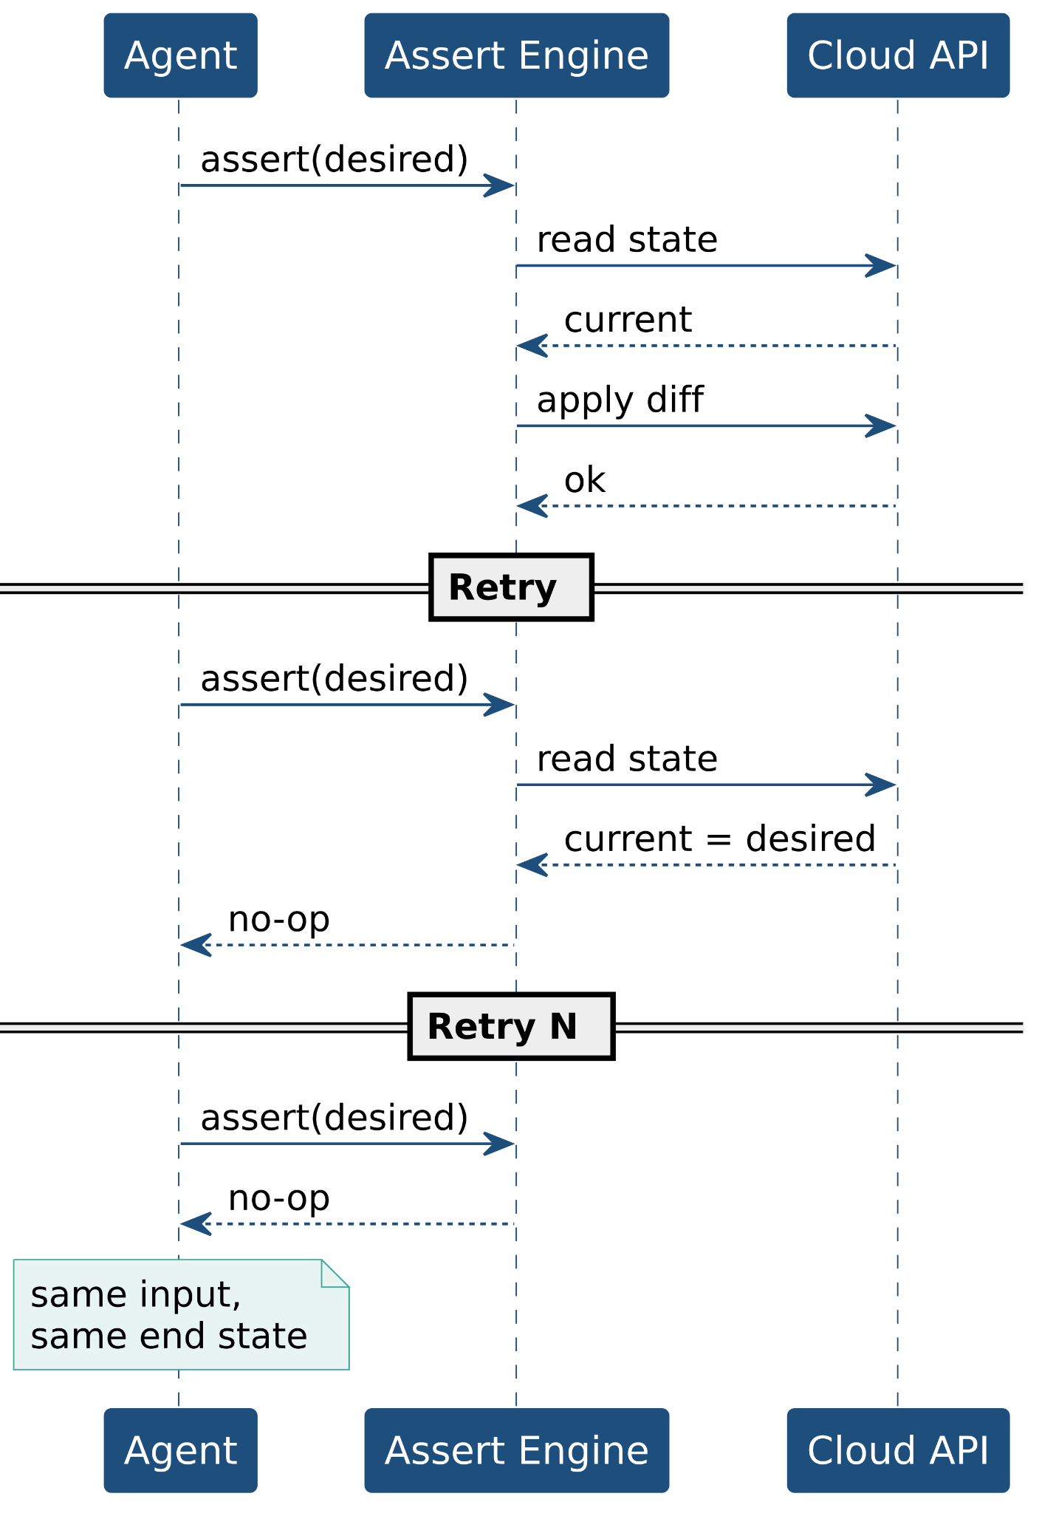
02
IDEMPOTENT ASSERTIONS
Idempotent assertions, not imperative scripts.
“Agents retry and resume by default. If every call asserts desired state, every attempt converges on the same end state and the agent does not have to remember what it did.”
STACKQL>>
Notes:
Declare what should be, not how to get there.
Retries are safe because the engine handles the diff.
Agents retry, parallelise, and resume from partial failures by default.
If your interface assumes a single clean execution, agents will break it.
If your interface assumes assertions, they will not.

Slide 16
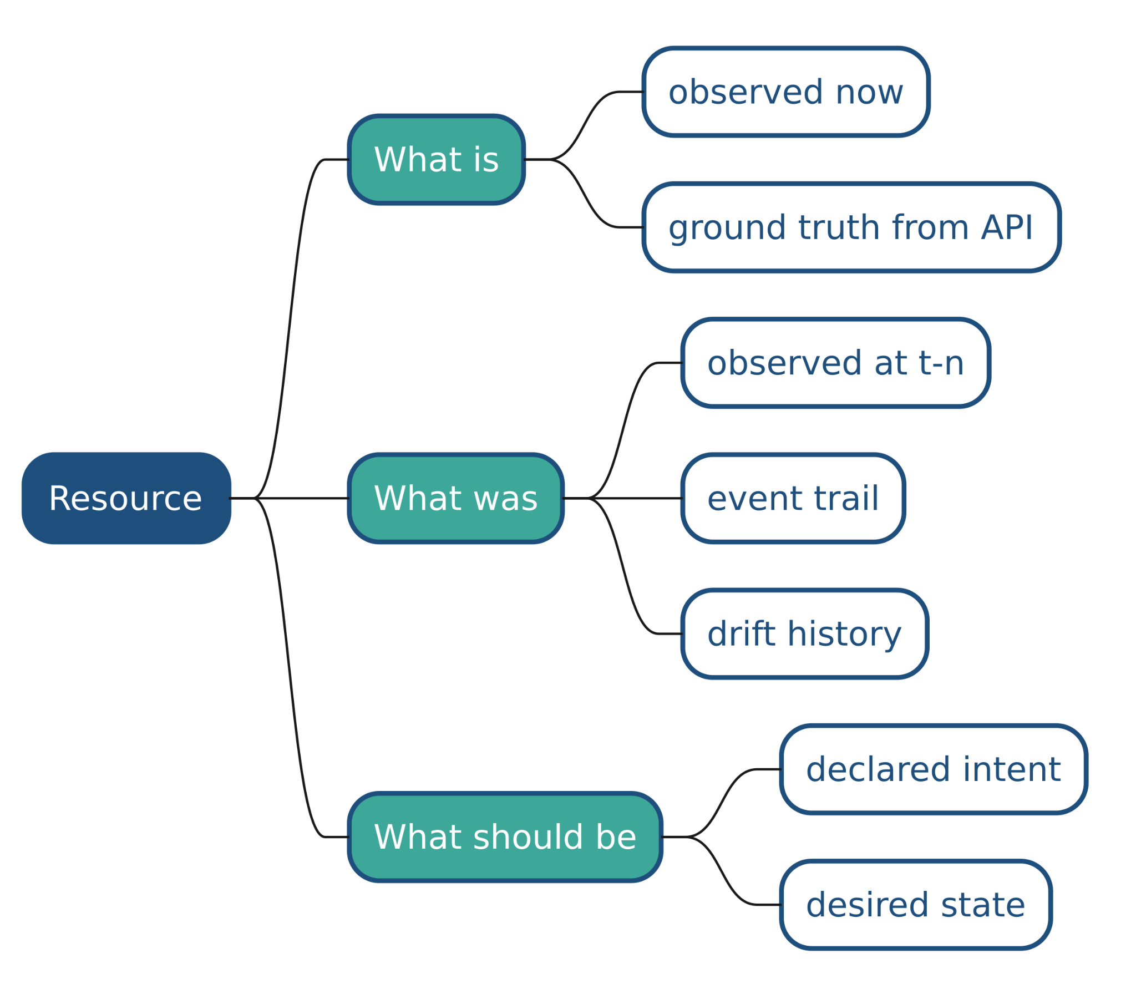
03
BI-TEMPORAL VIEW
What is. What was. What should be.
"Keep reality, history, and intent as separate queryable views, and drift becomes diagnosable instead of alarming."
STACKQL>>
Notes:
Three views, kept separate.
What is, observed now.
What was, the trail of observations.
What should be, the declared intent.
Most tools collapse these into one state file and lose the history.
Keep them separate and drift stops being an alarm and starts being diagnosable.

Slide 17
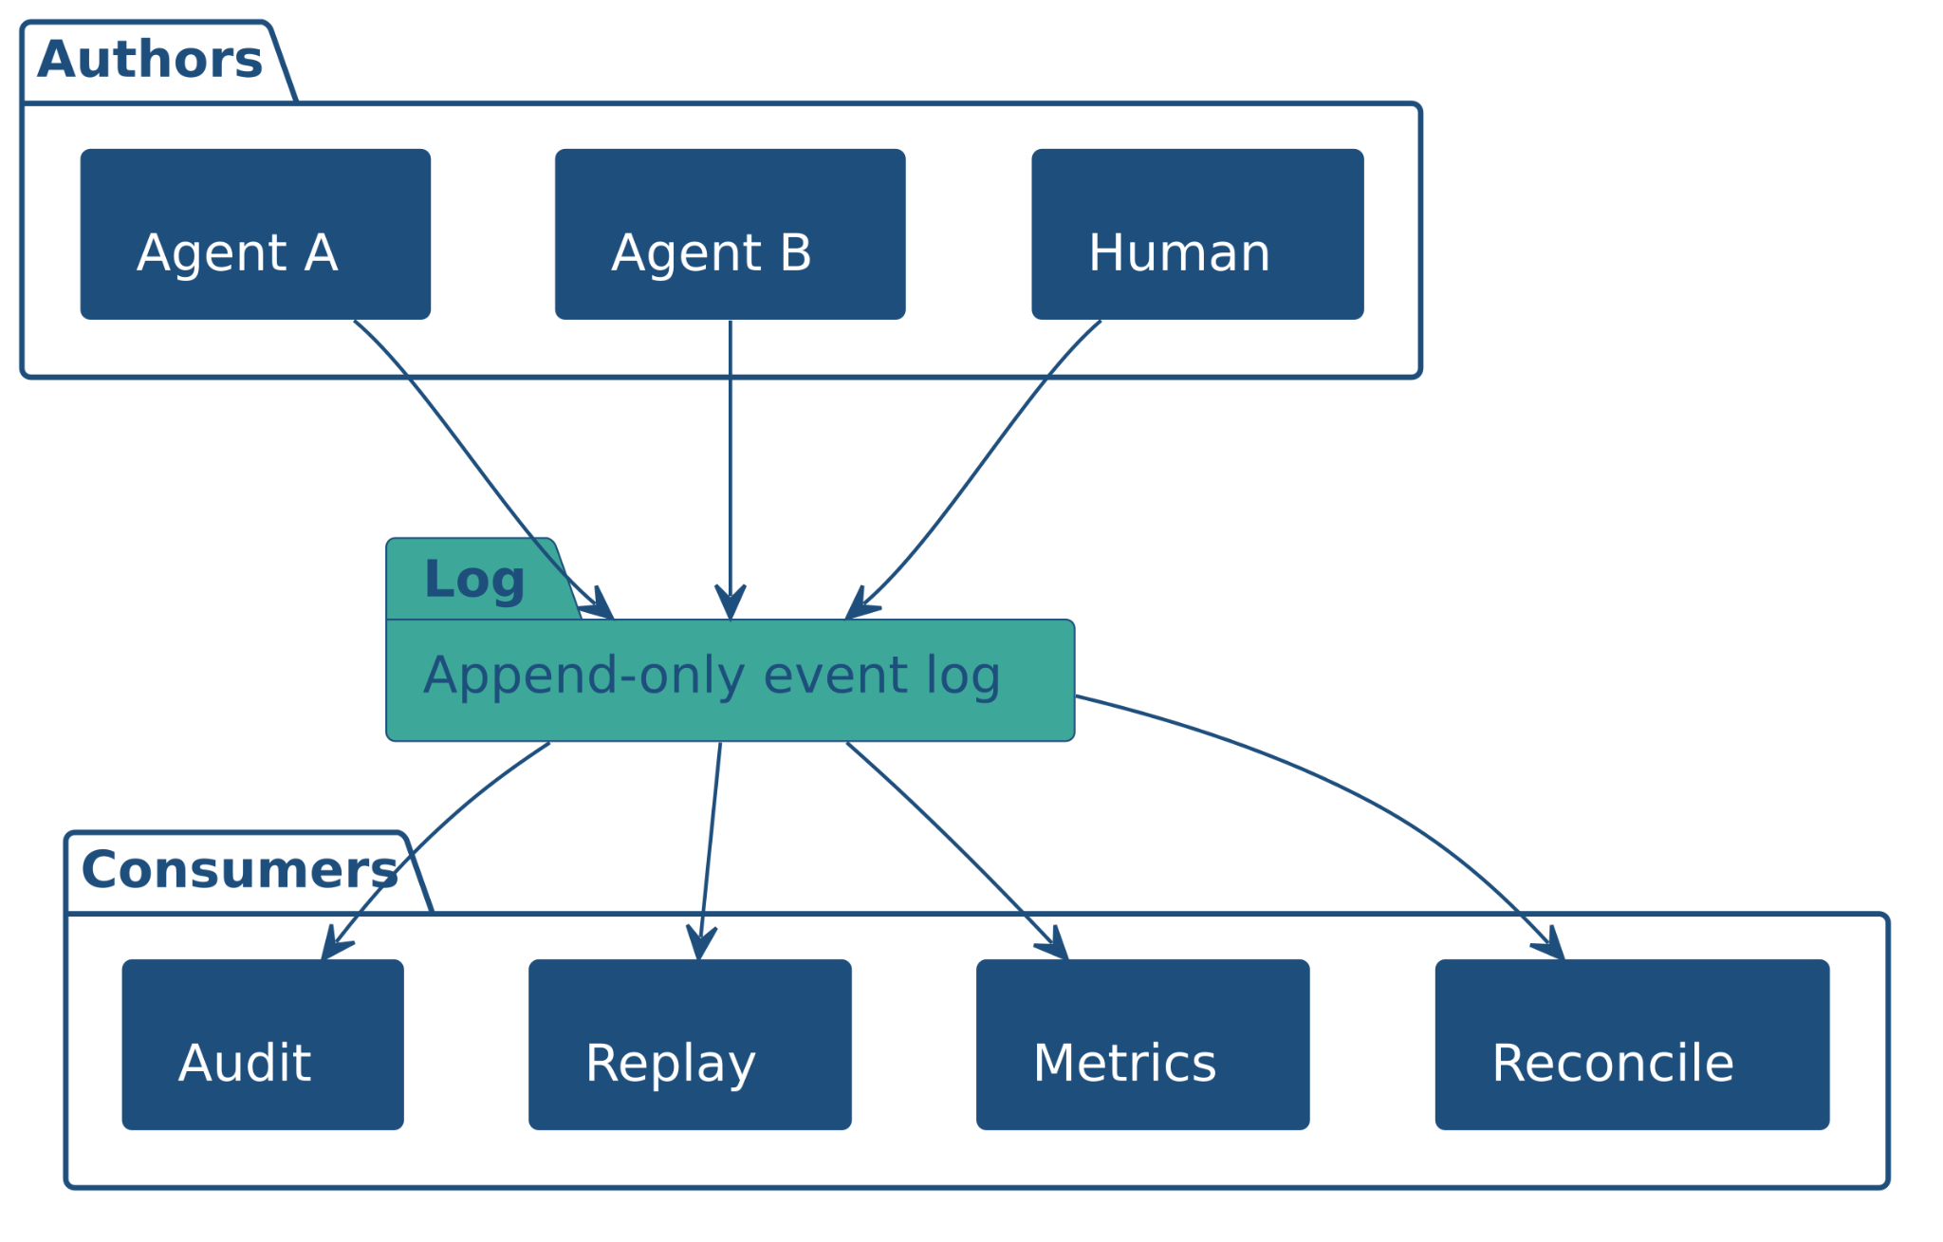
04
AGENTS AS EVENT SOURCES
Agents as event sources, feeding audit and replay
"If every mutation is published as an event, the audit log stops being a separate artefact. It becomes the substrate that audit, replay, metrics, and reconciliation all read from. Each event carries its origin: the intent, the trigger, the agent identity. What happened and why are the same record."
STACKQL>>
Notes:
Every mutation, by any author, becomes an event.
The audit log is not a separate compliance artefact bolted on after the fact. It is the substrate.
Replay, metrics, reconciliation all read from the same log.
Agents do not need a special audit story if they are event sources by default.
What happened and why give us “Intent provenance”

Slide 18
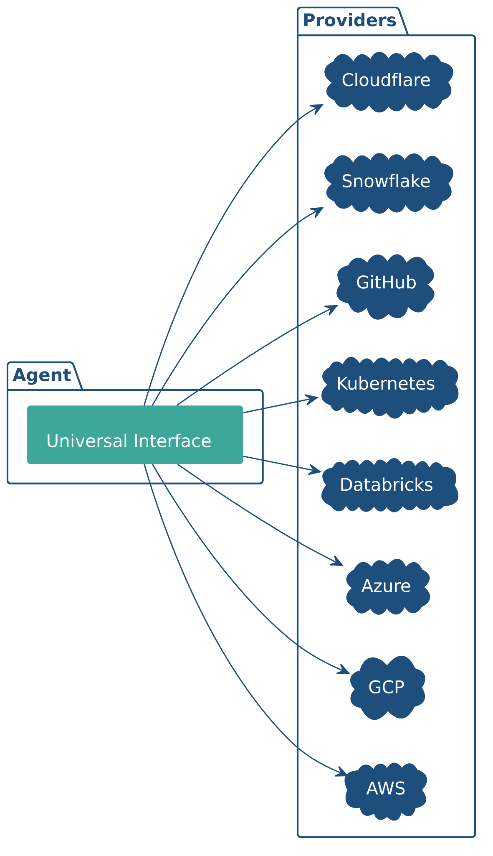
05
UNIVERSAL INTERFACES
One query shape, every provider.
"A single query shape across providers means one thing to learn and one thing to plan against, instead of a different SDK per cloud."
STACKQL>>
Notes:
One query shape across providers.
Agents that have to learn a different SDK for every cloud spend most of their tokens on plumbing.
A single interface collapses that.
The provider-specific surface is still there underneath; it just stops being the agent's problem to model.

Slide 19
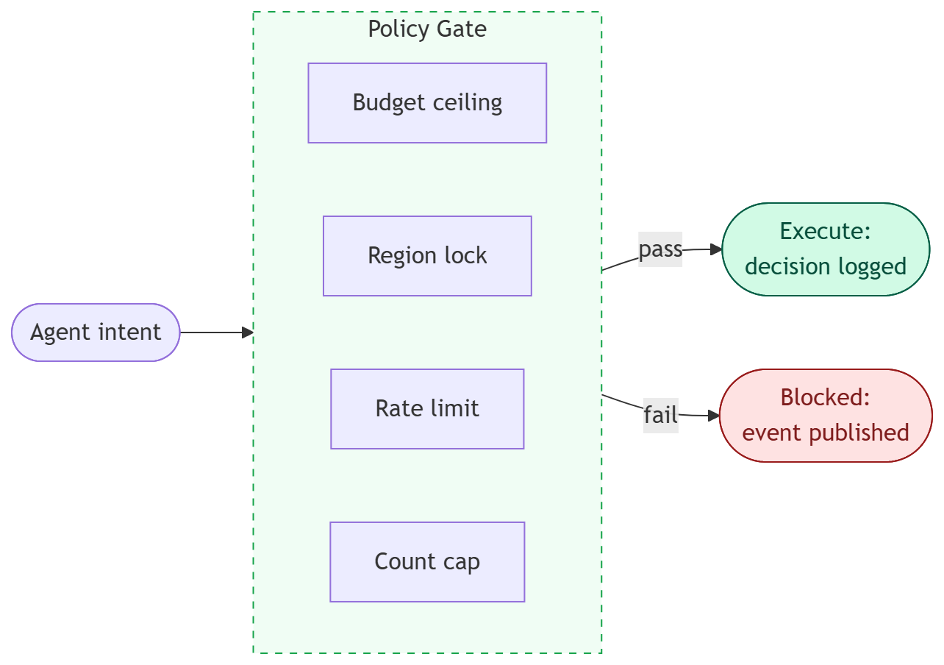
06
POLICY GATES REPLACE REVIEW CYCLES
Bounded Execution
"The review cycle bounded what humans could do by accident. In the agent era, execution bounds do the same job by design: budget ceilings, region locks, change rate limits, resource count caps. Policy is not a compliance artefact. It is the new safety loop."
STACKQL>>
Notes:
Human review was the safety loop. Agents bypass it by design, so something has to replace it.
Policy gates are that replacement - declarative rules the agent evaluates against its own intent before acting.
Four constraint categories: spend, geography, change velocity, resource count. Together they bound what an agent can do by accident.
Policy is not a compliance layer bolted on after the fact. In the agent era it is the safety loop.

Slide 20
DEMO
STACKQL>>

Slide 21

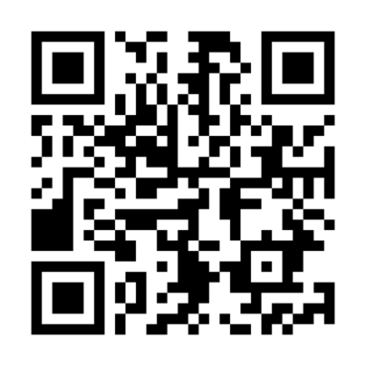

CLOUD
COMPLIANCE
SECURITY
MCP
AUTOMATION
ASSURANCE
THANK YOU
STACKQL>>
stackql.io

